Slide 1
The Zen of Coding
The Coding Bootcamp

Slide 2

Quick Introductions! (30 seconds)
Name
Location
Background (Career, Education, Interests)
Why learn web development?
Excited about class?
Notes:
This class is, after all, about you – so let’s do some introductions.
(You may also want to ask “Fears about class?” – that can turn a little negative, so be ready to dissuade/make happy the students if you do ask this)

Slide 3
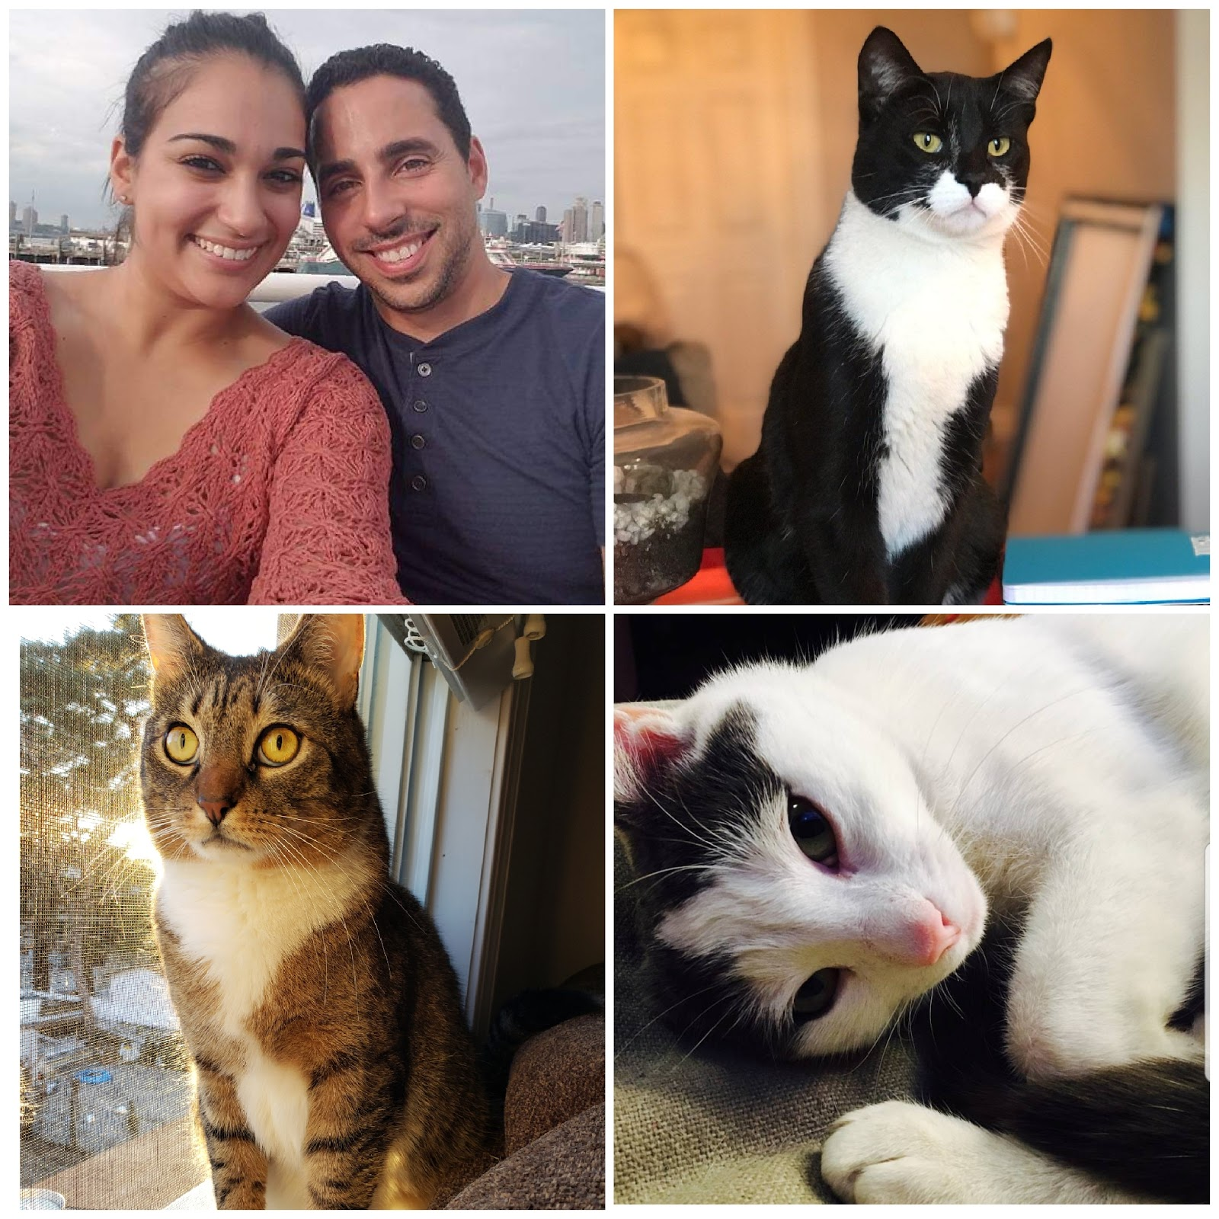
TA = … ?
Yoan Ante
Completed a coding bootcamp myself
Now do freelance work
BS in Computer Science
Started and sold my own business
In the military for 8 years after high school 4 active duty and 4 in the Air National Guard
Crazy Cat Guy: Chief, Amigo, Sasha
Notes:
Enough about you, time to talk about me.
So I was in the military for 8 years after high school 4 active duty and 4 in the Air National Guard. I was an aircraft mechanic and I worked on the F-15 and F-16 fighter planes. When I left the military I went to school and studies computer science. I left school with just a few classes left before graduating in 2011 to open my own business which I sold in 2018. When I sold the business I returned to school and finished my BS and I also enrolled in Flatiron school to get more practical knowledge. I know do some freelance work and TA at Columbia.

Slide 4
More about Yoan

Slide 5
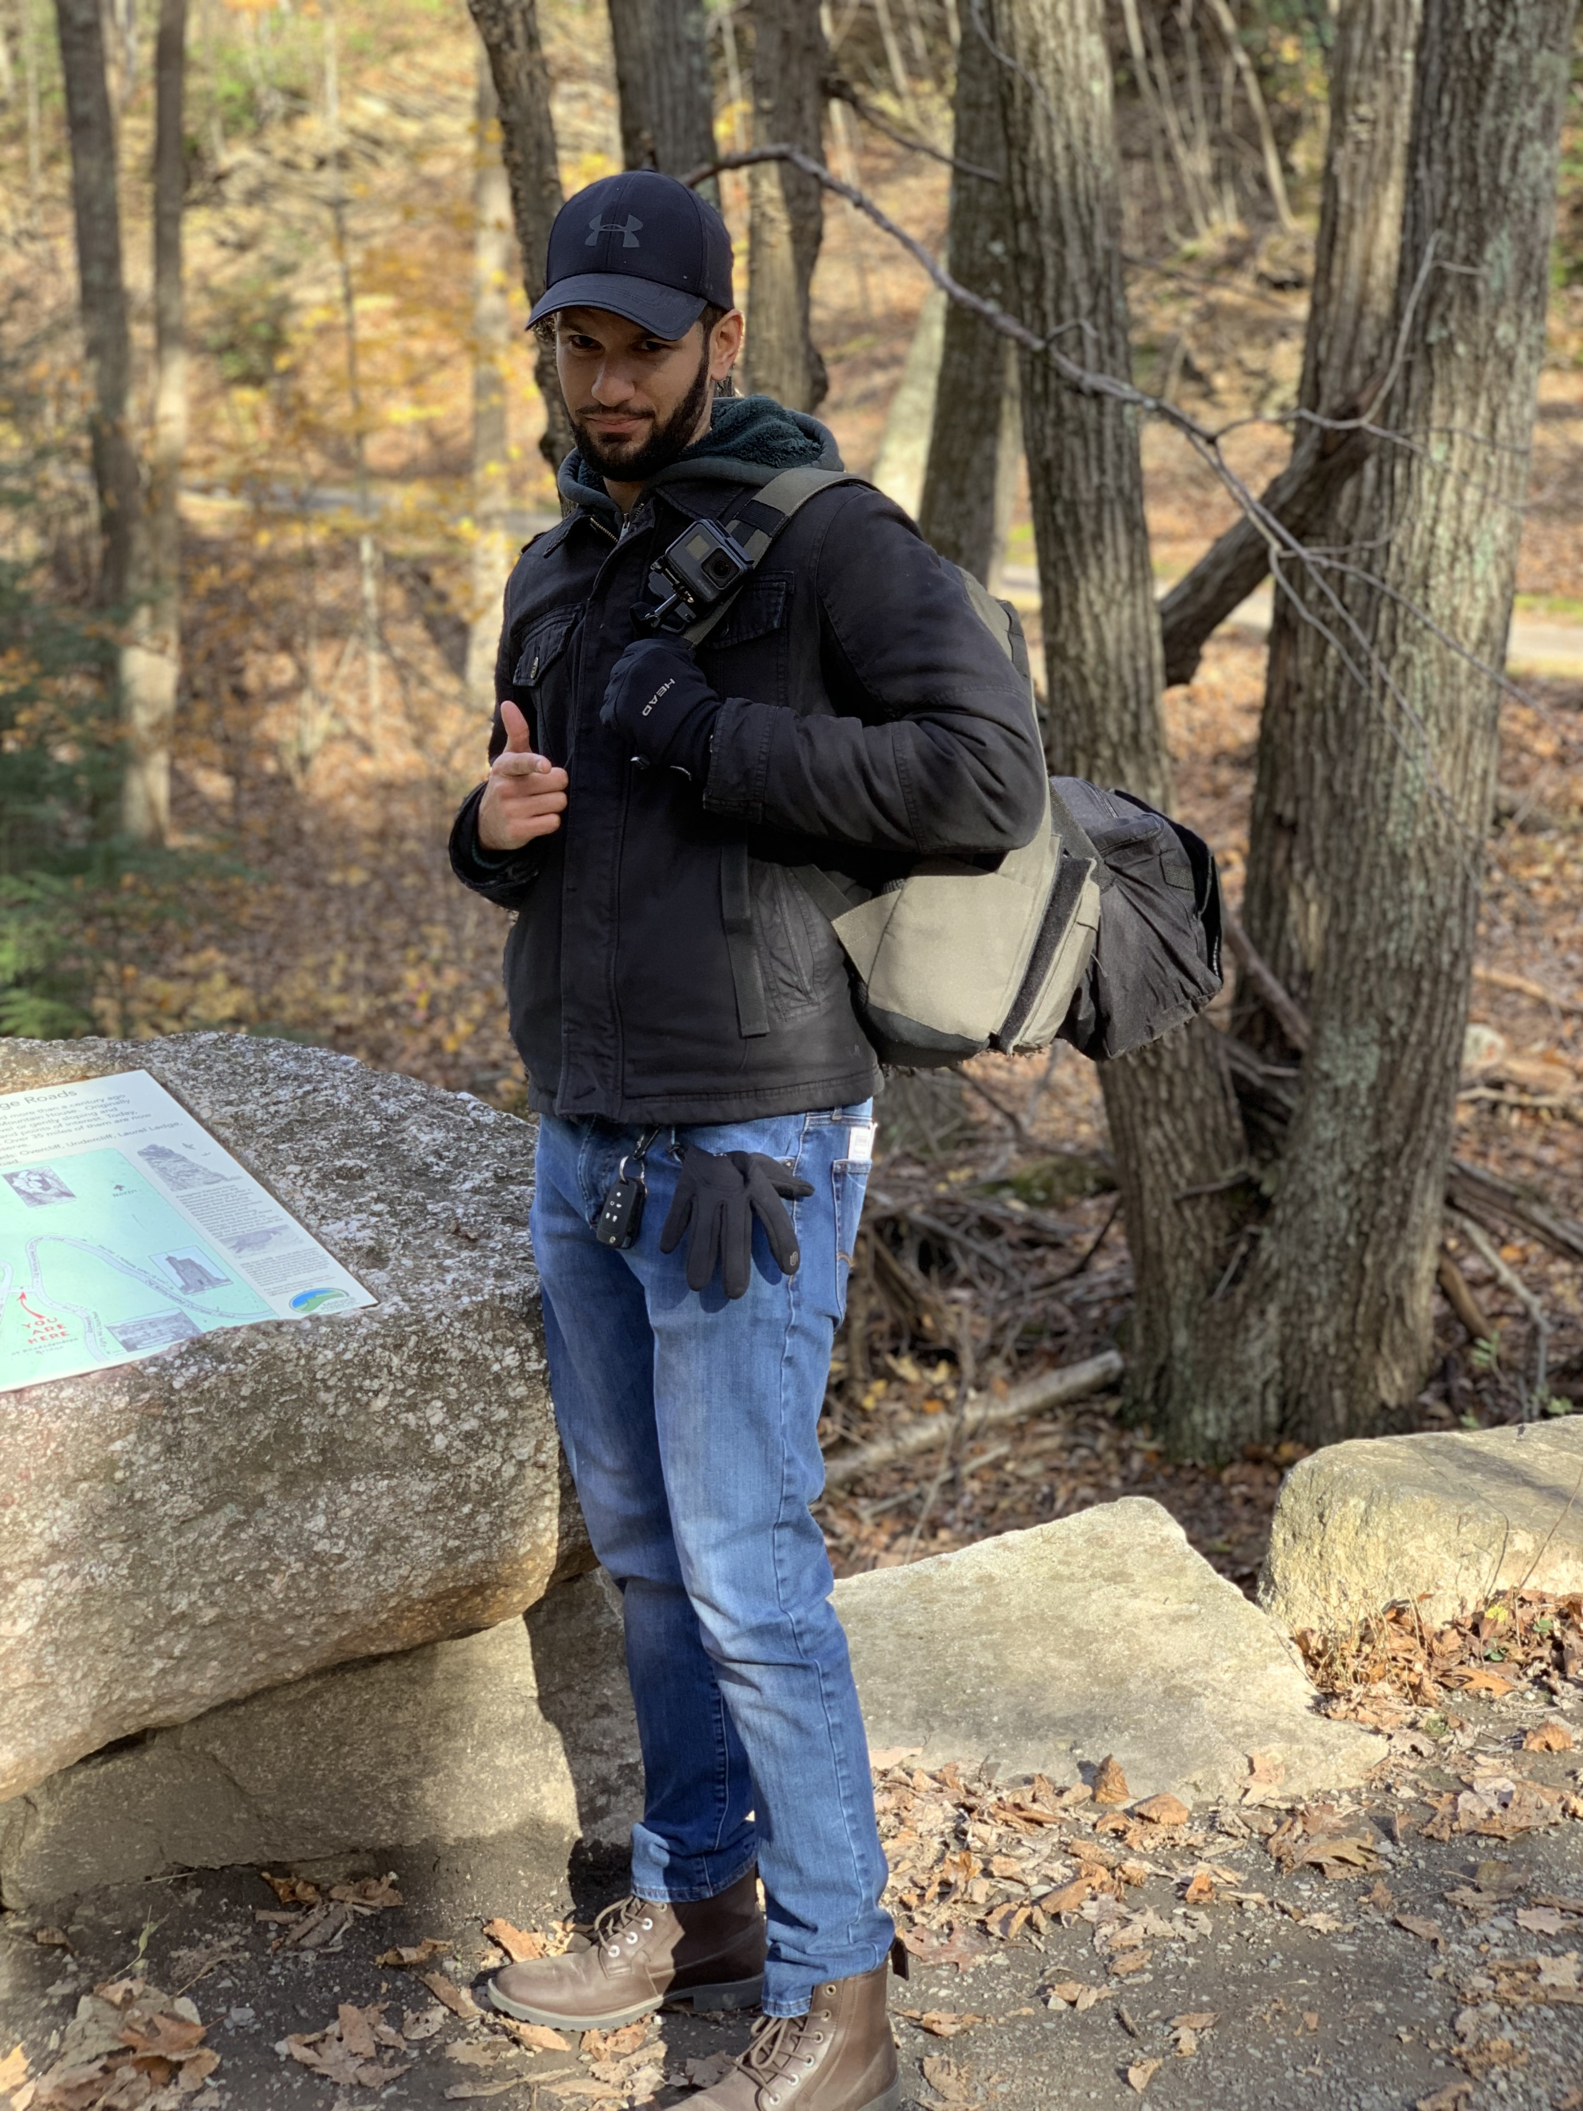
TA = … ?
Jonathan Ferreras
Bachelor’s degree, Computer Engineering at New York City College of Technology
Currently employed at the MTA as Application Developer
About a 1.5 years of professional experience
Interest in drones, robotics, making music, and watching good movies (feel free to recommend some ☺)
Notes:
Enough about you, time to talk about me.

Slide 6
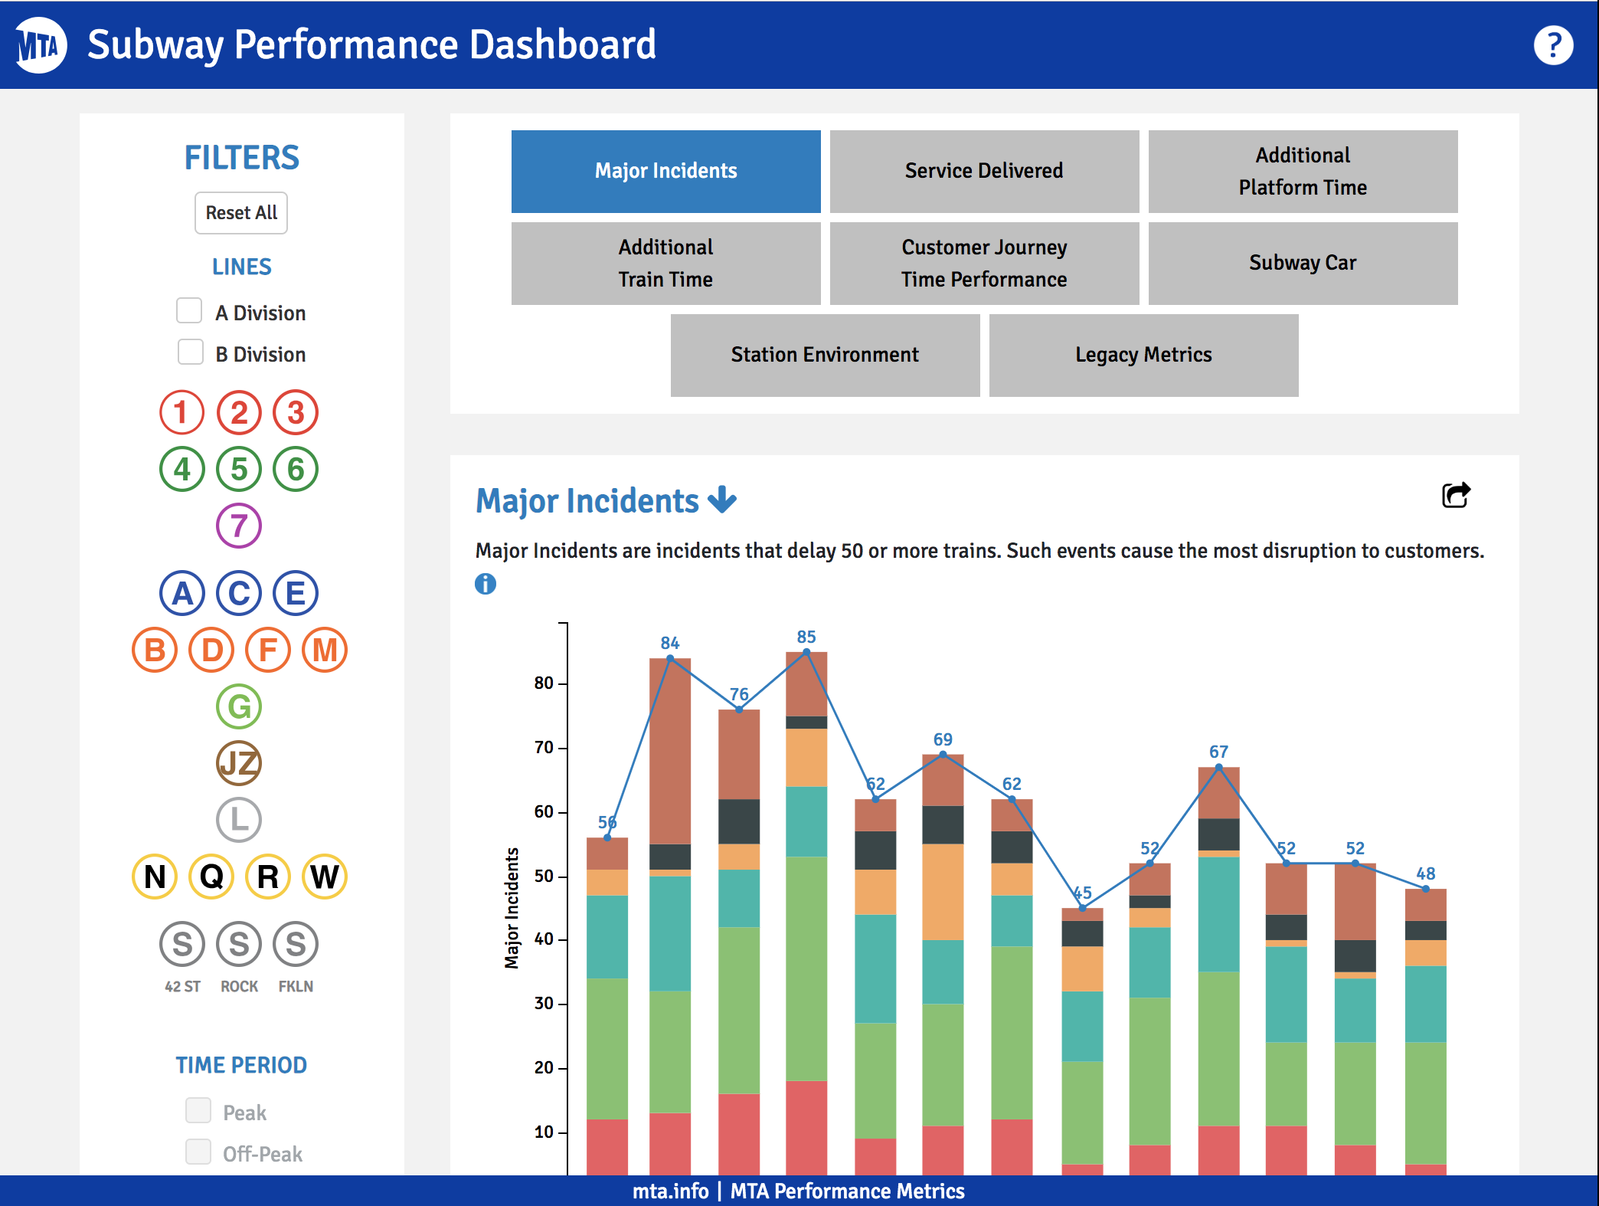
Projects Jonathan Worked On…
Notes:
Here’s this cool thing I built. It does X and it’s important because Y.
Questions?

Slide 7
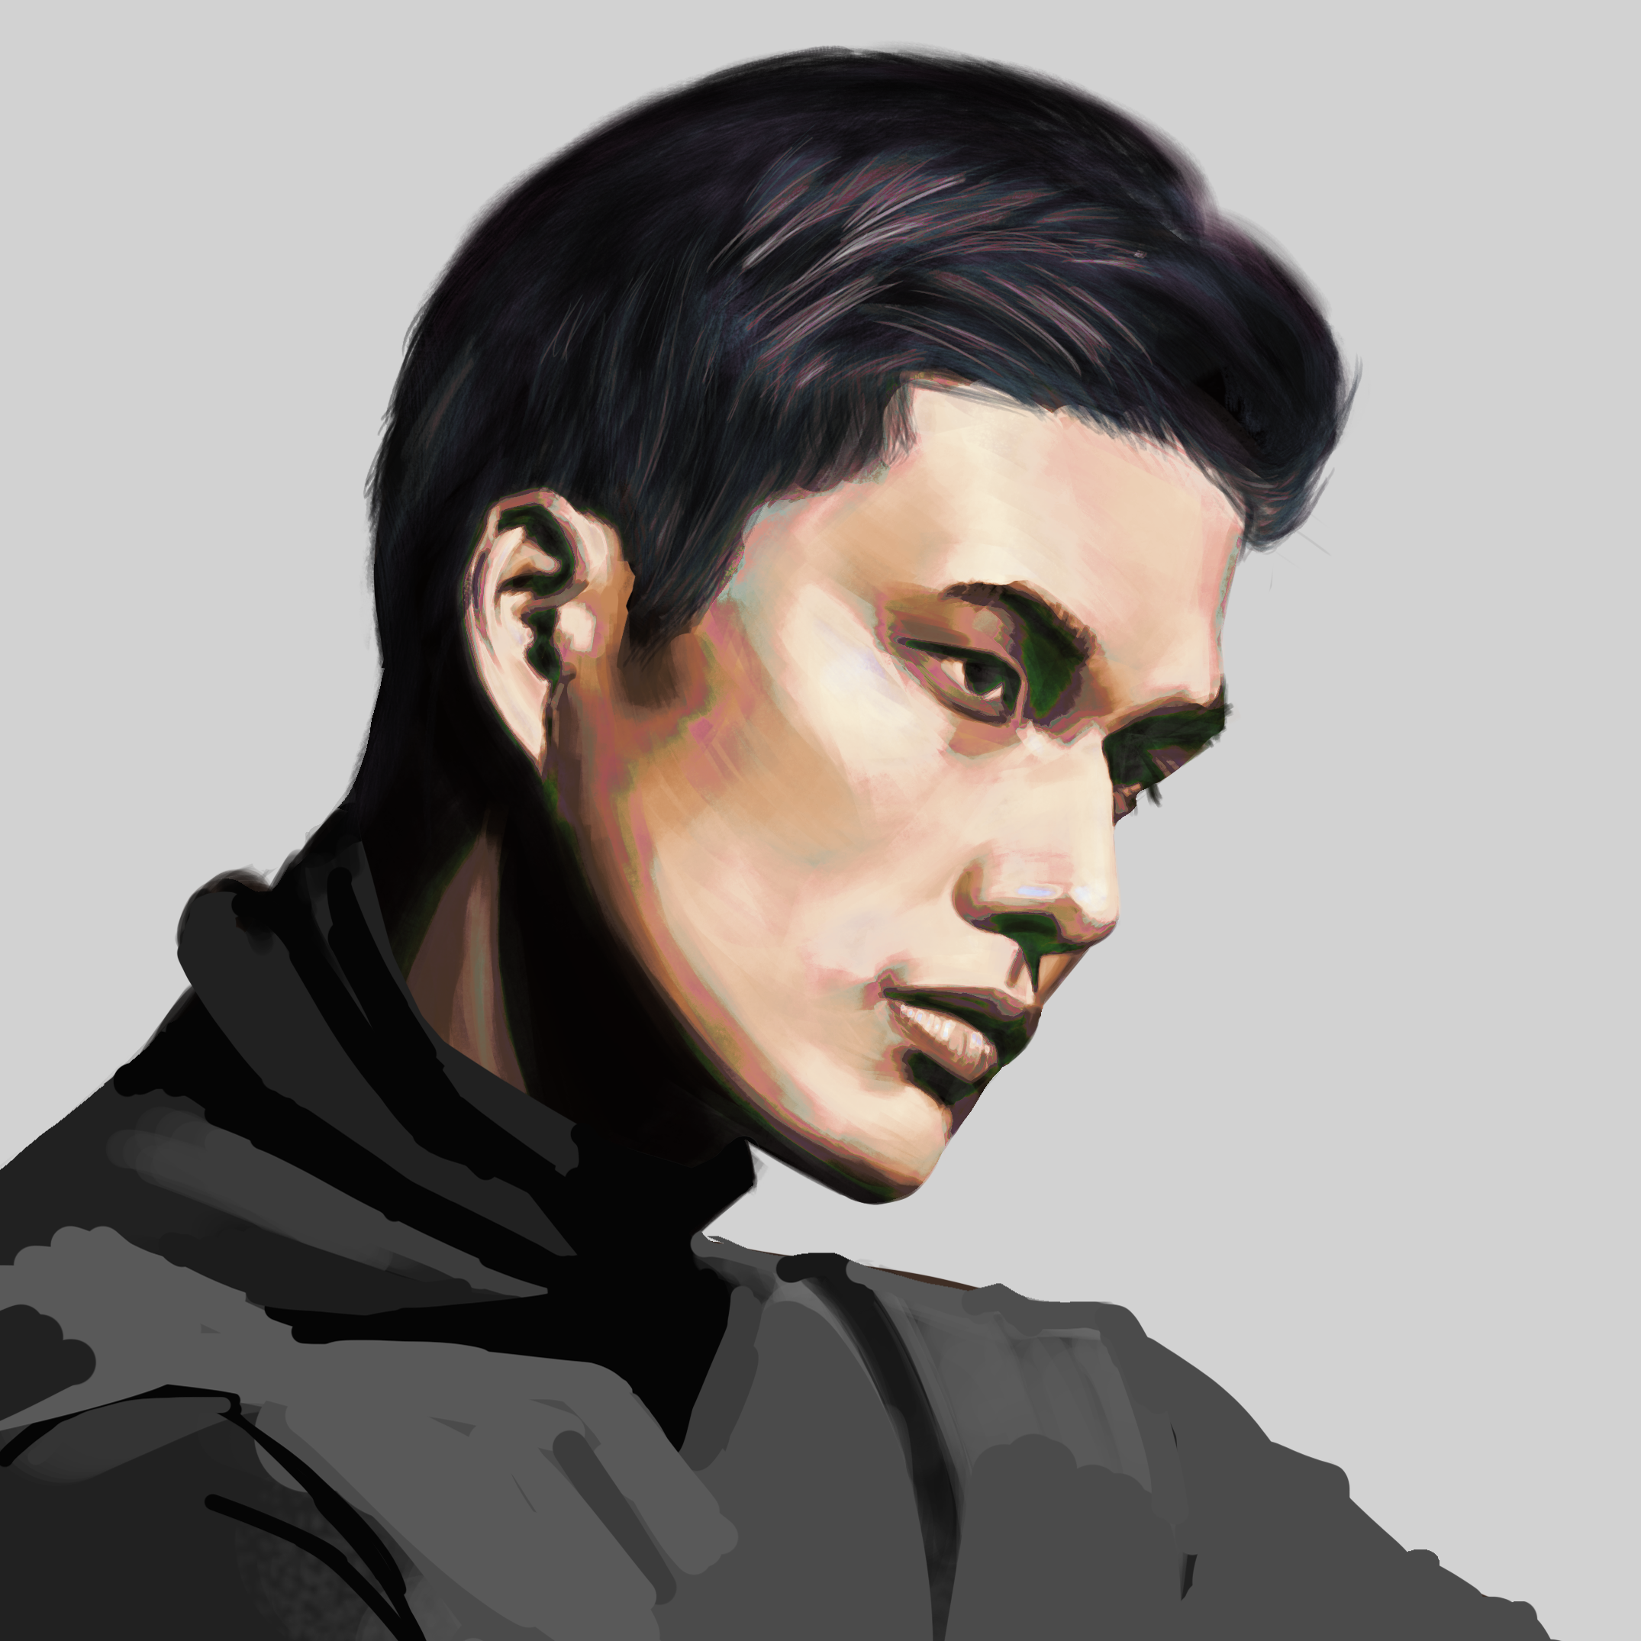
TA = … ?
Kevin Delvo
Studied Psychology at Stony Brook University. After graduation I worked as a barista, data entry specialist at a financial advising office and freelance illustrator.
Picked up coding as a hobby after discovering web development. Started out teaching myself HTML, CSS, JavaScript and JQuery. Went to Fullstack Academy of Code and graduated last year mid July. Briefly worked as a blockchain development intern and now work as a CA at Trilogy.
Over a year of coding, (with plenty of experience being a n00b at it.)
Other than art and coding, I enjoy combat sports. I did judo and boxing during college.
Secretly, a medieval armor junkie.
Notes:
Enough about you, time to talk about me.

Slide 8

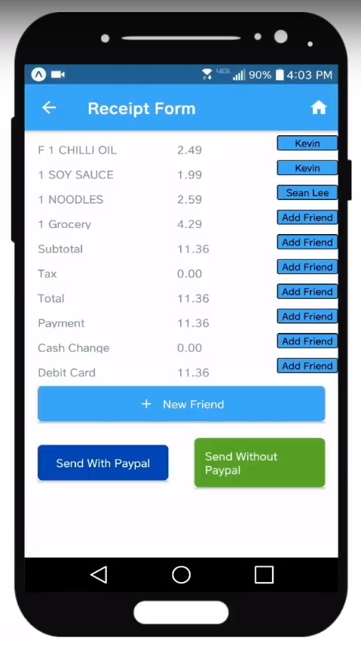
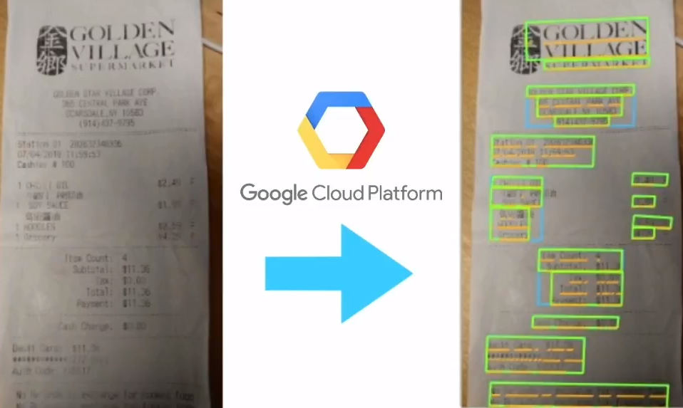
Some Cool Stuff Kevin Made…
Notes:
Here’s this cool thing I built. It does X and it’s important because Y.
Questions?

Slide 9
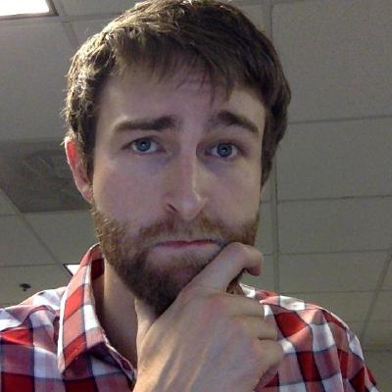
Instructor = … ?
Nick Bartlett
MS in CS from UNC, Math + CS Undergrad
Technical Lead/Architect @ IBM, Director of Engineering @ Trilogy Education Services
Over 10 years coding, (with plenty of experience being new at it.)
I enjoy biking, rock climbing, and running, and broke my leg skateboarding about 2 months ago.
Notes:
Enough about you, time to talk about me.

Slide 10
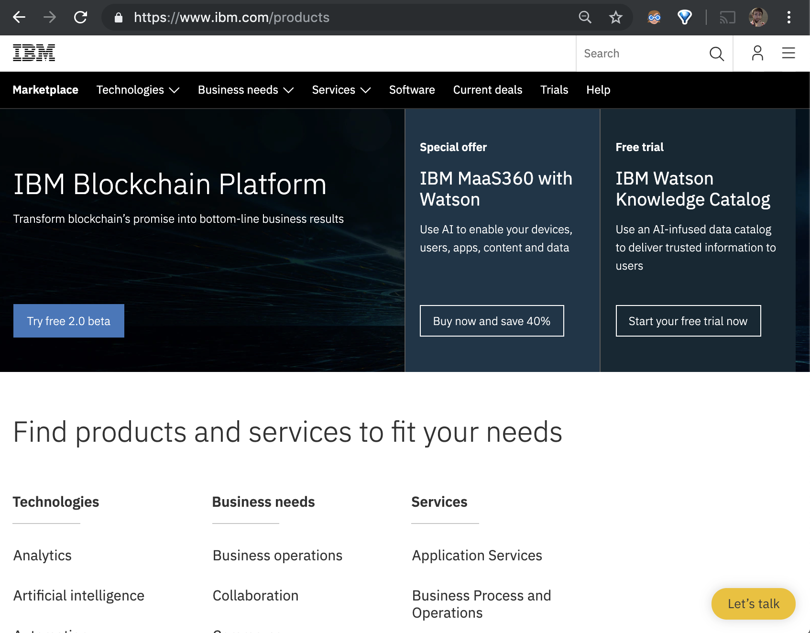
More about me

Slide 11
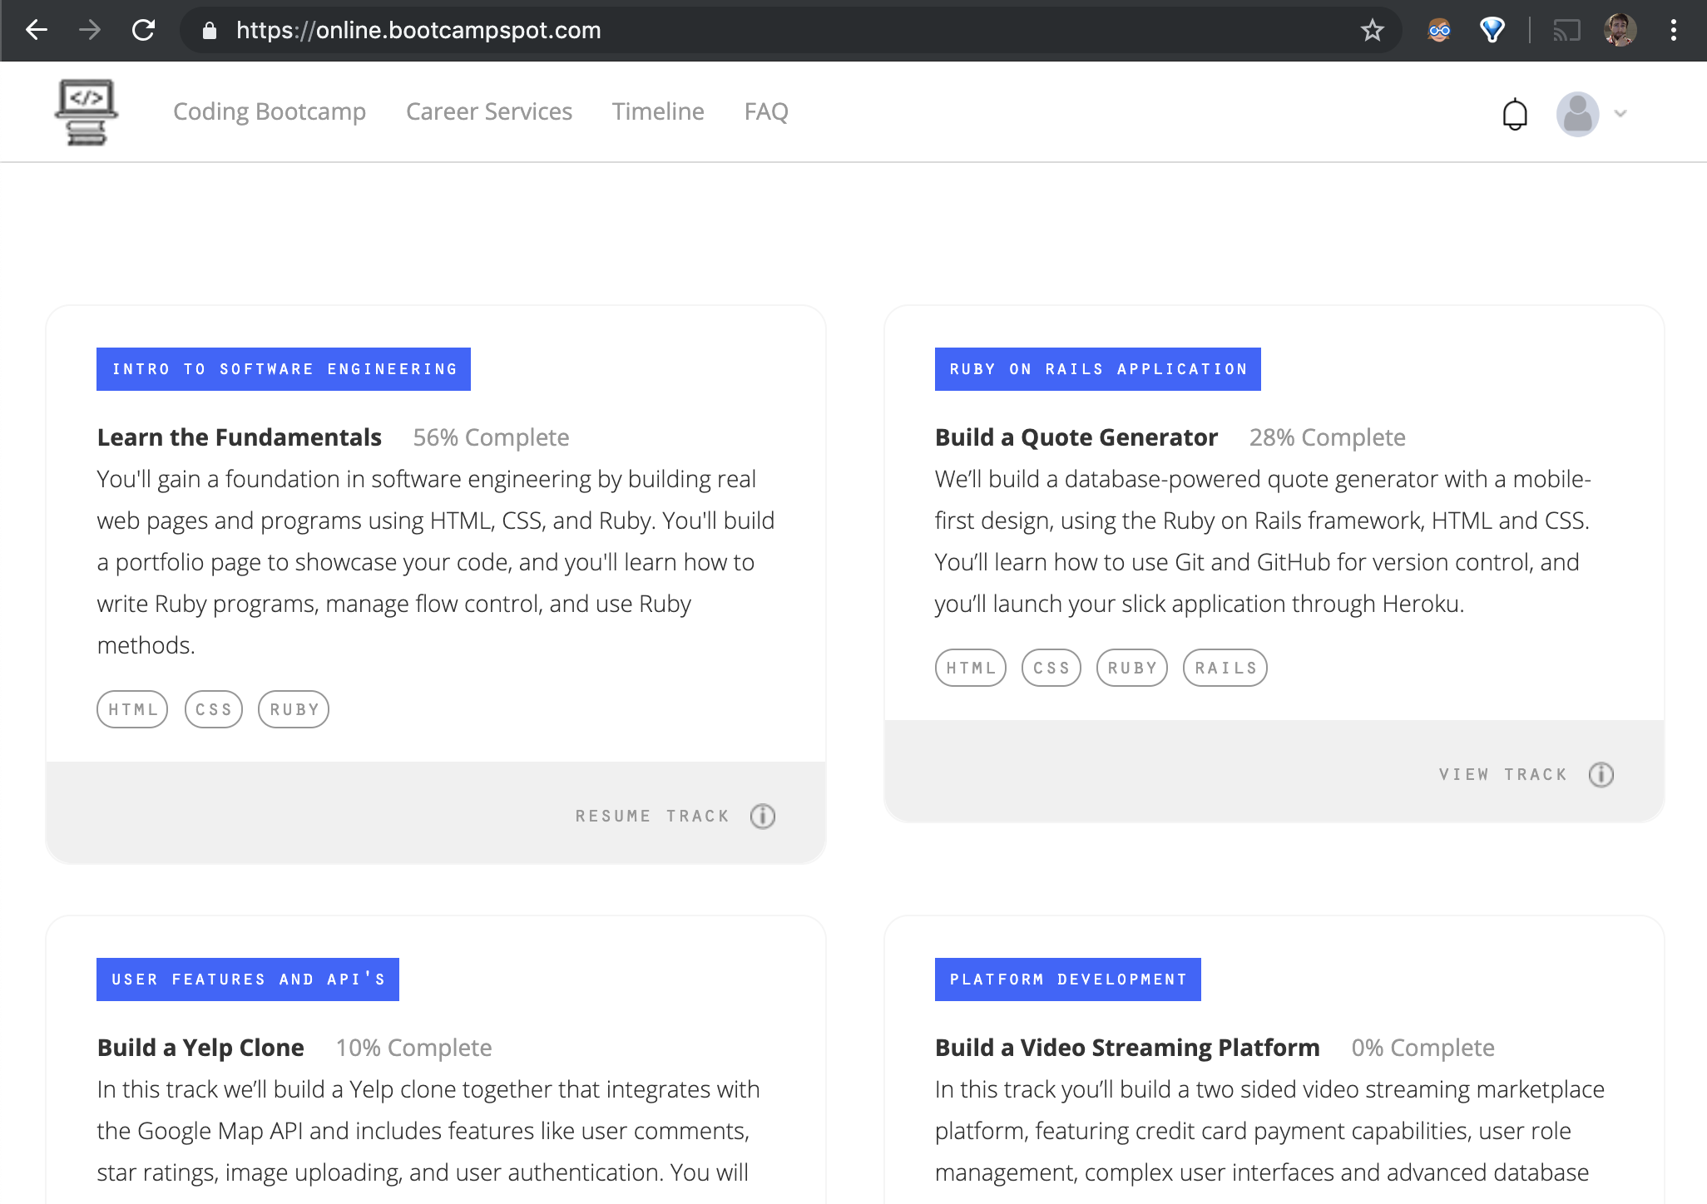
More about me

Slide 12
More about Nick

Slide 13
The Path of Learning

Slide 14

Your Goals...
New Career
Basically 1000% of you said…

Slide 15
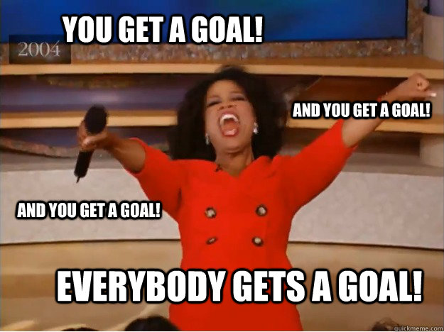
Your Goals...
And why do you want a new career?
To escape a “dead-end job”
To pursue a “dream”
To be able to “create”
To follow a “fascination”
To attain “financial stability”
To attain “financial freedom”
To “challenge” yourself
To be a “role model” for kids

Slide 16
Your Goal = Our Goal
As instructors,
we take your goals very, very seriously.

Slide 17
Support Team
Our Promise:
If you’re willing to put in the time – and you take our advice, we’re here to help you 100% of the way.
This goes for everyone working behind the program:
Instructors
TAs
Student Success Team
Career Coaches
Everyone Else!
Notes:
This program will not be a traditional college class. We're here to support you 100% of the way to really help you achieve their goals.

Slide 18
But Remember…
Nothing good comes easy.
Notes:
There are a few things you can do to ensure your success

Slide 19
On Keys To Success…

Slide 20
Don’t Be This Guy…
Notes:
First off, don’t be this guy.
Those that have the hardest time in the program are not the ones who came in knowing no programming.
It’s not the ones who haven’t played around with HTML, CSS, or Javascript.
It’s the ones who walk in thinking they either A) Know more than they do. Or B) Are experts in a completely different field.
There is something that stops people like this from accepting the reality.

Slide 21

This Should Be You.
Notes:
Be this guy. Having a humble attitude is the first requirement of being successful in this program.

Slide 22
Our Mantra for Today and Beyond…
When it comes to web development…

Slide 23
Our Mantra for Today and Beyond…
I know nothing.
Notes:
Don’t be frustrated! Keep an open mind – you’re here to learn.
You mastery of other subjects, educational backgrounds, and professional successes do not guarantee that you will do well here. The only thing that will guarantee success is hard work, humility, and a relentless desire to be better.

Slide 24
You.
Notes:
You are a blank slate. Seriously. Don’t lose sight of this image. At first it may feel intimidating. Knowing how little you know. But relish the opportunity and take the privileges it comes with.
You have permission to struggle. To fail. To not “get” everything immediately.

Slide 25
The Path of Learning
Notes:
So how does one learn? Well…

Slide 26
Nothing Comes Easy…
As students, you face three
HUGE obstacles!
Notes:
… there are a few obstacles in the way.
Things that will frustrate you…

Slide 27
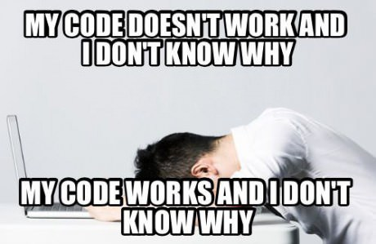
Obstacle #1 – The Great Confusion
Notes:
Obstacle 1 First, learning to code is tough, intimidating, and frustrating at times. You should forget about your uncle/brother-in-law/friend/step-sister who told you about so-and-so learning to build apps in 1 week. Coding is hard. It will take time. There is no way around that.
It’s confusing, difficult, and there’s a ton to learn. But it’s super rewarding when you _do_ learn why your code broke or is working.

Slide 28
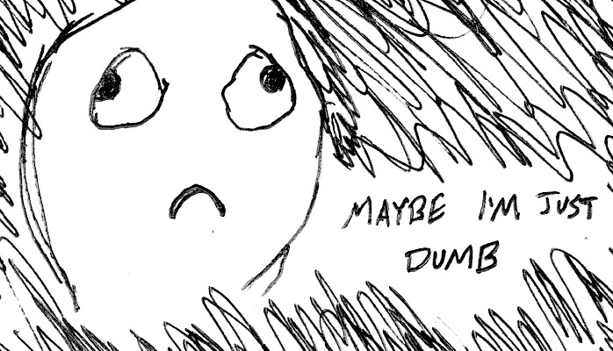
Obstacle #2 – The Great Doubt
Notes:
Obstacle 2
There will be many moments where you will doubt yourself.
Everyone is on the same page as you. No-one in this classroom is dumb. You all have varying backgrounds with differing experiences and exposure.
Everyone was where you are at some point in their career. Every single developer. Me too.
It takes time but you have what it takes; you were selected for this program because we know you have what it takes.
The first few weeks will be difficult, but everyone will be on a pretty level playing field a few weeks in.

Slide 29

Obstacle #3 – The Great Distance
Notes:
Obstacle 2 – you have a ton of ground to cover!
There’s a lot to learn, and it can be intimidating. But honestly, 6 months will be over before you know it.
Because of the length of the program, personal issues WILL come up during the course of the program, and it will be challenging to stay motivated.
You should see each other as a family embarking on a long journey. You will become far closer to your peers than you realize. Intensity is no substitute for endurance.

Slide 30
Nothing Comes Easy…
Learning to Code Requires Two Things:
Persisting in the face of something that feels incredibly hard and confusing.
Maintaining the self-confidence necessary to believe that you CAN DO THIS.
Notes:
And will take a while to master. Persisting in general is the #1 hardest thing in this course.
Perhaps tied with having self-confidence (talk about imposter syndrome).

Slide 31
Learning is “Frustrating”
“You can’t tell whether you’re learning something when you’re learning it—in fact, learning feels a lot more like frustration.”
“What I’ve learned is that during this period of frustration is actually when people improve the most, and their improvements are usually obvious to an outsider. If you feel frustrated while trying to understand new concepts, try to remember that it might not feel like it, but you’re probably rapidly expanding your knowledge.”
Jeff Dickey, Author of Write Modern Web Apps with the MEAN Stack: Mongo, Express, AngularJS, and Node.JS
Notes:
Frustration = learning, seriously. Here’s the author of a pretty famous book on the mean stack:
So how do we get through this frustration and actually learn?

Slide 32
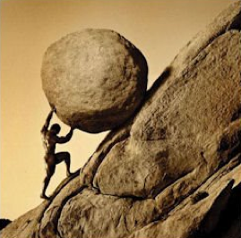
Advice for the Journey
Throughout this course, always remember to:
Work Hard!!

Slide 33
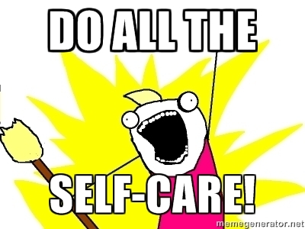
Advice for the Journey
Throughout this course, always remember to:
Work Hard!!
Appreciate your successes

Slide 34

Advice for the Journey
Throughout this course, always remember to:
Work Hard!!
Appreciate your successes
Trust yourself
Notes:
Questions?

Slide 35
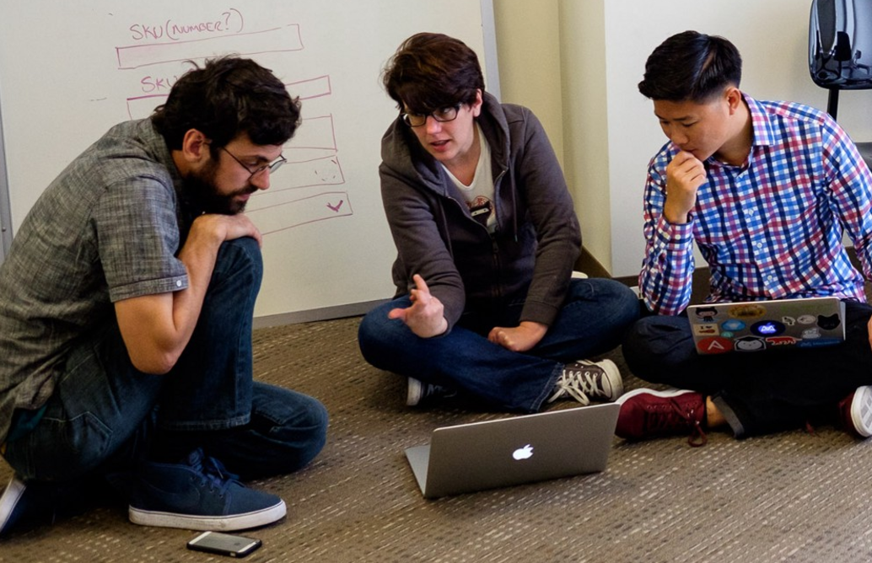
But remember…
If you want to go fast, go alone.
If you want to go far, go in a team.

Slide 36

Google Fu – The Most Important Skill of All
What is Google Fu?
Notes:
Of course, to do this, you’ll need to be great at googling!
This is arguably the best/most important skill you can use.
It’s silly, but being able to find the answers to your questions is extremely important, and people won’t always be around. Google should almost always be your first go-to (it has almost every answer, if you know how to find it).

Slide 37
Course Structure
Notes:
Now that we’ve talked about the journey and how to be successful, let’s talk about the stops along the way.

Slide 38
Daily Schedule
For each class we’ll run through the following:
Set Objectives
Brief Background Lecture
Watch Me / Coding Demos
Code Discussions
In-Class Exercises
Project Work
Notes:
Here’s what our days will look like.
Question: How do you learn to code? (NEXT)

Slide 39
Daily Schedule
For each class we’ll run through the following:
Set Objectives
Brief Background Lecture
Watch Me / Coding Demos
Code Discussions
In-Class Exercises
Project Work
The Super Important Stuff!!!
i.e. Always be coding!
Notes:
By coding! Unfortunate, right?
We’ll get a ton of in-class practice reading and writing code, so the course quickly becomes “code-centric”.
Most days will be much less presentation-heavy than today.
Questions?

Slide 40
Pre-Work
Notes:
So next up I want to spend a little bit of time checking that everyone has everything they need installed (from the pre-work).
If you can check off all of these things, spend this time helping your neighbors. This should become a habit – try to ask for help form your neighbors before going to a TA (you will both learn more along the way). < We’ll talk more about this soon.
That said, let’s check some things off of a list.

Slide 41
Software Checklist
At this point, you should have each of these installed:
Slack
Visual Studio Code
Git for Version Control
Git Bash (Windows) or Terminal (Mac)
Node.js
Heroku-CLI
Google Chrome

Slide 42
Accounts Checklist
You should also now have accounts for:
GitHub (with SSH Integration)
Heroku
LinkedIn
Stack Overflow

Slide 43
Self-Check
Let’s do some quick checks of the following
Visual Studio Code Check
Git Bash / Terminal Check
Node Check
Git Check
Heroku Check

Slide 44
Let’s Get Crackin!

Slide 45
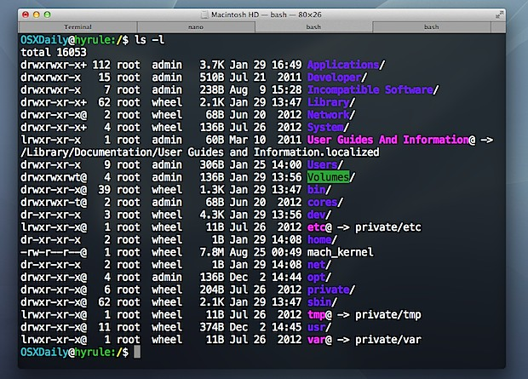
Intro to Console / Terminal
Notes:
The terminal is the portal to your computer – it allows you to run and even script commands that can create files, folders, and more.
It is extremely important that you get intimately familiar with the terminal as soon as possible, as you’ll use it for almost everything. It is fast and powerful.
NEXT

Slide 46
INSTRUCTOR DEMO
Instructor: Demo
(1-ConsoleCommands)
Notes:
So let’s run through a couple of examples.

Slide 47
> YOUR TURN!
Activity: Get Situated | Suggested Time: 1 min
Assignment:
Make a folder on your desktop named code.
Put all of your code that you do inside of that folder.
Best Practices:
Always use lowercase for folder and file names.
Never put in spaces in your folder and file names.
Use dashes to separate.
Notes:
Your turn!

Slide 48
> YOUR TURN!
Activity: Console Commands | Suggested Time: 12 min
Assignment:
From the Terminal / Console and using only the command line, create:
A new folder with the name of first_day_stuff.
A new HTML file with the name of first_day.html.
Open the current folder containing the new HTML file.
Bonus:
Create multiple directories/folders with the names one_folder and second_folder in one command.
Create multiple files with the names one.html and two.html in one command in the first_day_stuff directory.

